Slide 1
Team – One Click
Lowe's hackathon submission
-Internal store guidance system-

Slide 2
Problem Statement
Whenever you go to a store/mall for shopping, time is wasted in finding and navigating an item/shelf. There is a need to make the navigation simple and fast.
Also, due to coronavirus many stores are operating under-capacity and often gets overcrowded which increases risk of infection.
We need to have a solution that can enable user find items quickly so that purchases are faster, efficient and avoid overcrowding.

Slide 3
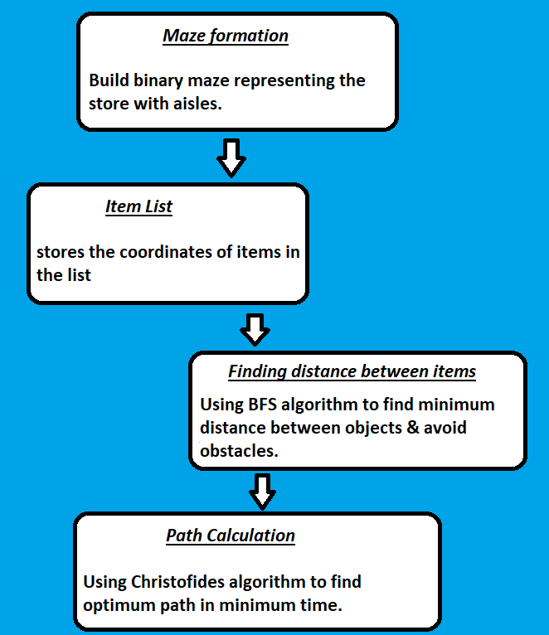
Solution Approach
Christofides algorithm finds optimal path in minimum amount of time.
Breadth First Search (BFS) Algorithm find the distance in all cases in the fastest time as compared to A* and DFS algorithm.

Slide 4
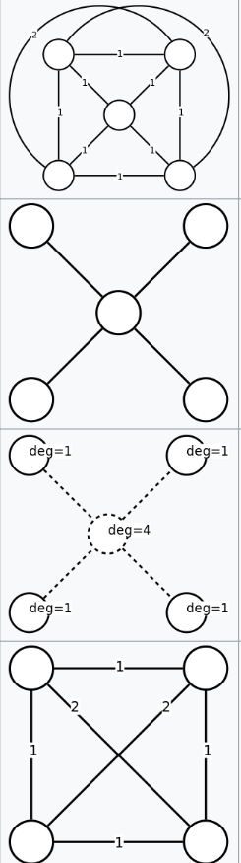
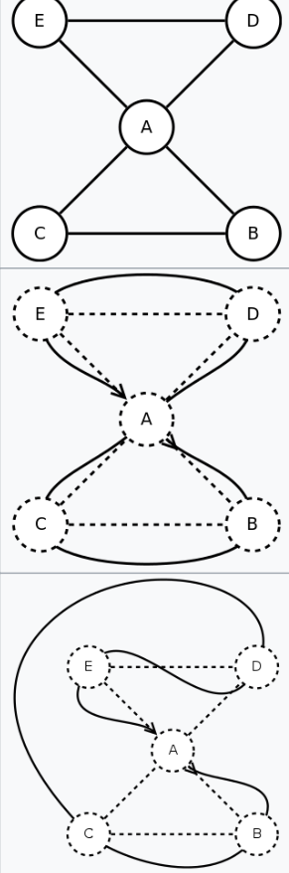
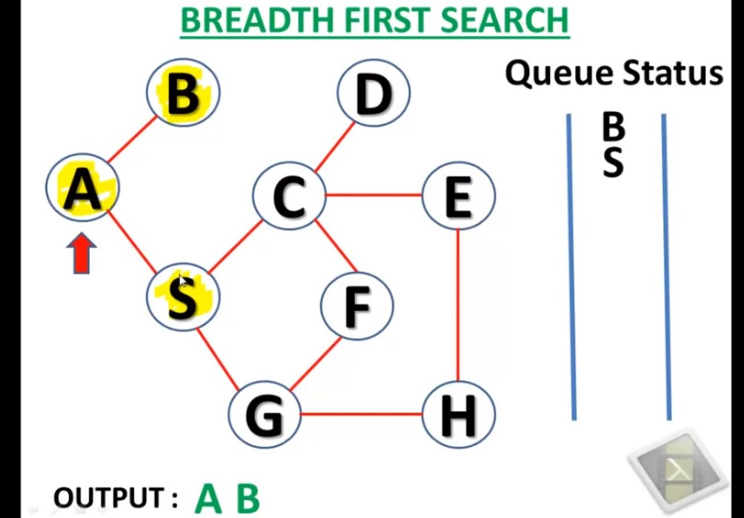
Algorithms Used
Christofides Algorithm BFS Algorithm

Slide 5
Additional Improvements
Apart from the core functionality we have added Analytics which are useful for store owners.
Store owners can measure :- footfall, retention rate, demographics, lifetime value of customer, Impulse purchases and gender.
Modified Christofides Algorithm to introduce entry and exit points which makes navigation easy and optimized.
Improved the UI and made the process of creating a store easy with just a mouse click.

Slide 6
Assumptions while designing
Currently we support only horizontal and vertical aisles.
Distance between consecutive aisles must be at least 1 unit to allow path between them.
For ease of testing make a store with dimensions 35x35. But any rectangular store will do.
While adding coordinates of items add the item one unit to left/right(for vertical aisle) or above/below(for horizontal aisle) of aisle. Do not add item directly on it.
This only needs to be done by store manager and not by the customer.

Slide 7
Technology and Tools
Software used
Hardware requirements
We have used python for building our solution.
JSON & SQL lite for database.
We chose python because it is easy to use and powerful.
We recommend a computer with minimum 8GB RAM.
1 TB HDD, SSD would be an added advantage.

Slide 8
Challenges Faced
GUI challenge – Using inbuilt functions(buttons) caused the program to lag and give a bad user experience.
Algorithm Dilemma – Out of the many algorithms out there it was a challenge to choose one which was optimal for use.
Hick-ups with python - It has call by object unlike other languages like C++ which allow us to decide when to call by value or call by reference.
Databases - Tried SQLlite, config.ini but it had a problem with storing complex matrices.

Slide 9
Learnings from the challenges
Fixed the GUI challenge by building the functionality from scratch which doesn't lag now. Also, were able to add zoom function.
Learned about various algorithm and chose Christofides and BFS algorithm to find optimal solution.
Learned about JSON and its implementation which helped in storing and retrieving complex matrices and data.
Learned about the application and importance of various metrics while implementing the analytics part for the store.

Slide 10
Build Instruction
1) Download Jupyter notebook as this has all required libraries inbuilt.
2) Copy code in a new python notebook.
3) Run code
OR
You can just run the .exe file which can easily be deployed.

Slide 11


Team
Arnav Khandekar
B.Tech - ECE
3rd year
IIIT Nagpur
Dhanraj Mahurkar
B.Tech - ECE
3rd year
IIIT Nagpur

Slide 12
In a nutshell
Our solution allows customers to locate an item easily and navigate the store quickly.
It saves time, avoids overcrowding and provides user analytics useful for the store owner.
It uses Christofides and BFS Algorithm to find shortest path in minimum time and avoids obstacles.
Simple UI - Anyone can build a store easily with a mouse click.

